Slide 1

Expense Management System
Stephen Prince Jeremiah
Sukhpreet Kaur

Slide 2
Content:
Purpose of document
Language Analysis
Customer Purchase Form

Slide 3
Languages and Frameworks Involved
SQL
HTML
PHP
Flutter
Dart
Android Studio

Slide 4
Purpose of document
Milestone Analysis
Development Initiatives and ideas.
Descriptive Code Analysis
Risk Management on Development
Language Risk Management

Slide 5
Milestone 2
Path Analysis of Project
Customer Requirement Analysis
Descriptive Analysis
Web Page Development
Development Testing

Slide 6

Login page Login Screen

Slide 7

Customer purchase form
Company name and logo

Slide 8



Customer purchase form
Checkbox
Dropdown Lists
Buttons

Slide 9
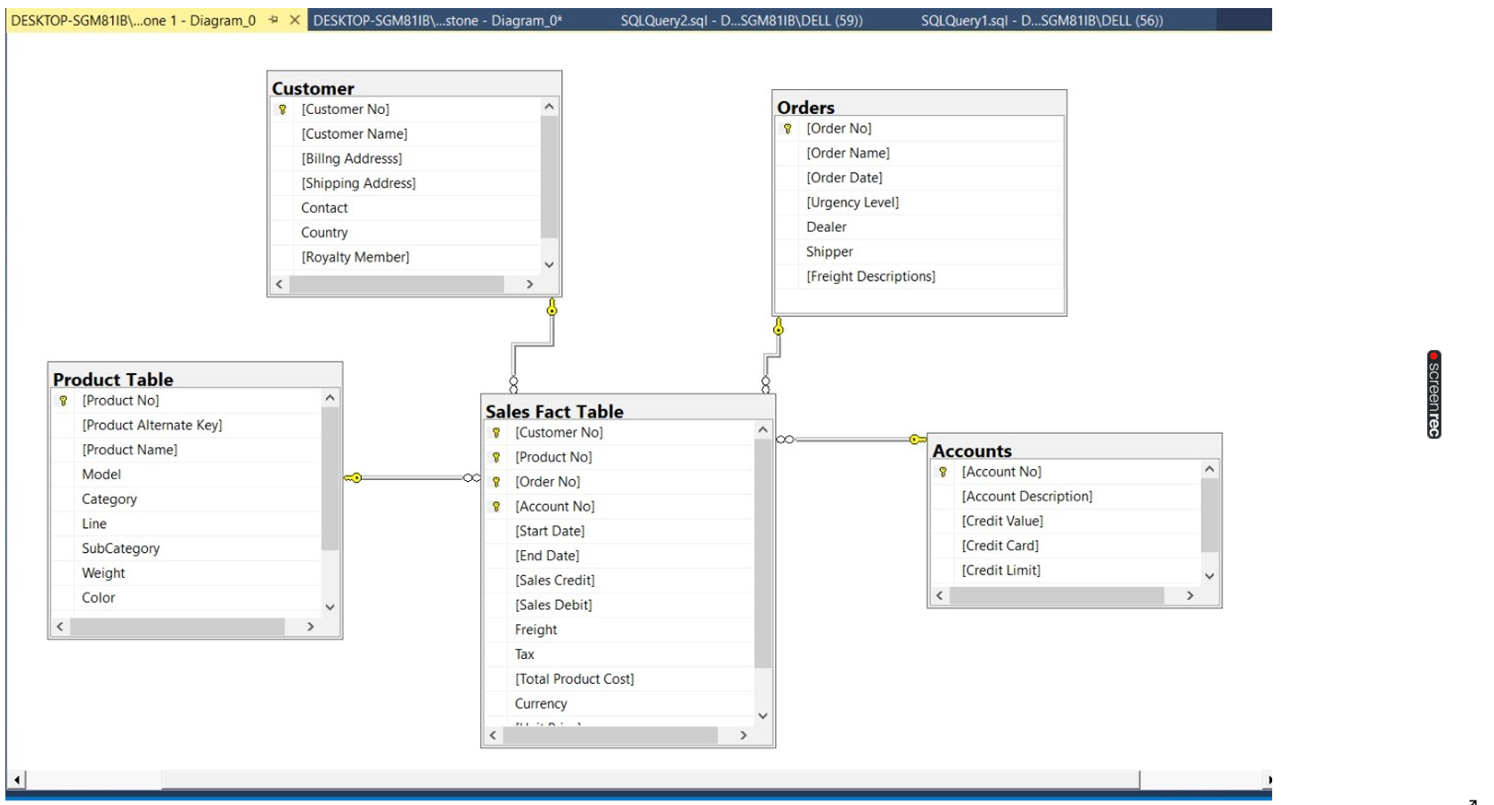
Database Diagram

Slide 10
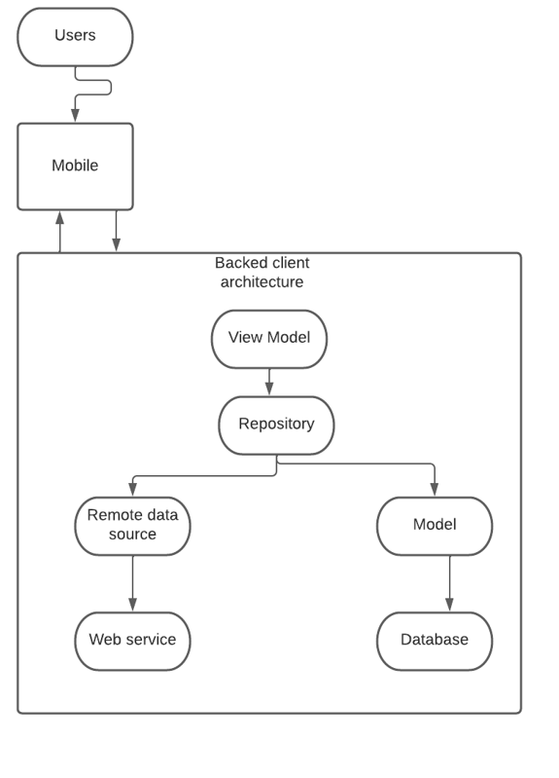
Server-Client Architecture

Slide 11
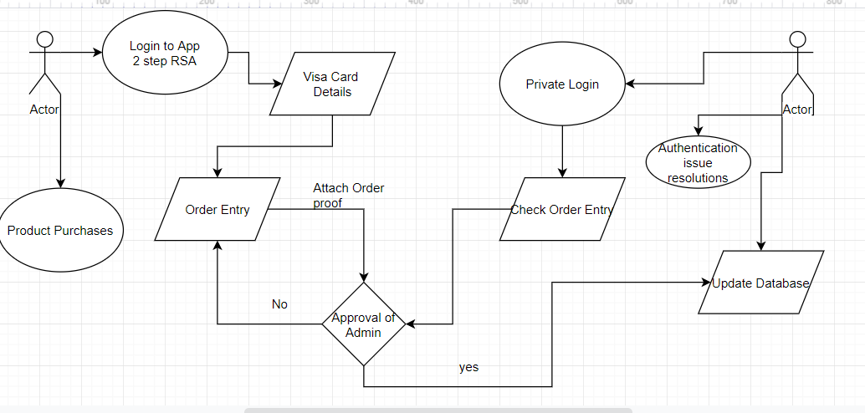
Activity Diagram

Slide 12
Actors-Roles
Customer
Admin

Slide 13
Conclusion
Software Infrastructure Analysis
Database Analysis
Server and Admin Responsibilities
Integration of different software
Environment Variable Setup

Slide 14
Roles
Members | Roles
Marc Bueno | Mentor/Advisor
Saad Aldin | Sponsor/SME/Product owner
Stephen Prince Jeremiah | Backend developer/Admin/Scrum master
Sukhpreet Kaur | Front end Scrum Developer

Slide 15

Thank you

